Slide 1

Chapter 4 Designing Combinational Systems
Full adder
Ripple carry adders
Carry look-ahead adders
Decoder
Multiplexer
Buffer
Bus
Gate arrays
  ROM
  PLA
  PAL
4 - <number>

Slide 2
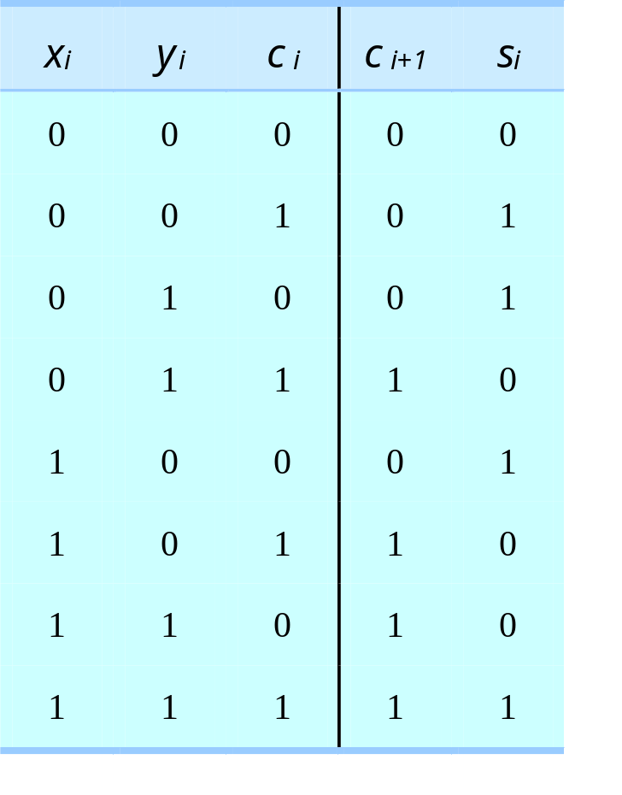
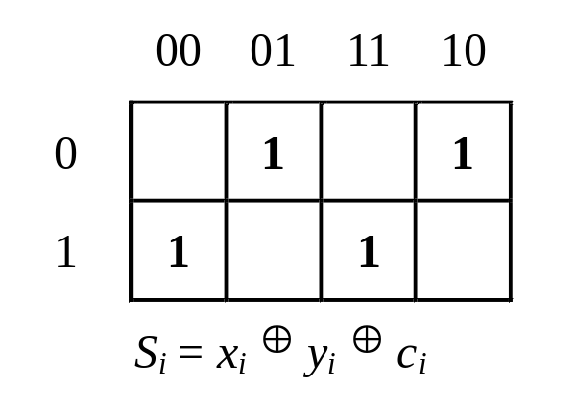
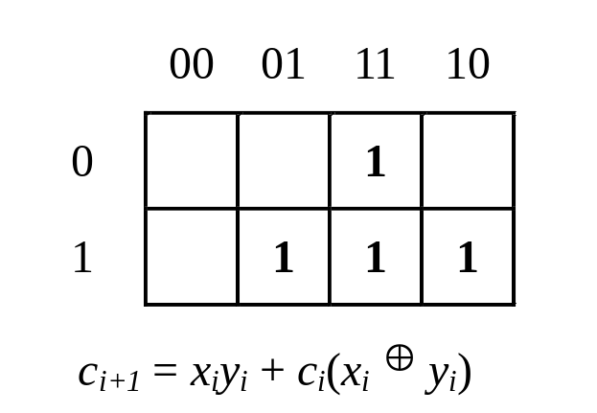
Full Adder
x_{i}y_{i}
c_{i}
x_{i}y_{i}
c_{i}
(a) Truth table for full adder
(b) Map representation
4 - <number>

Slide 3
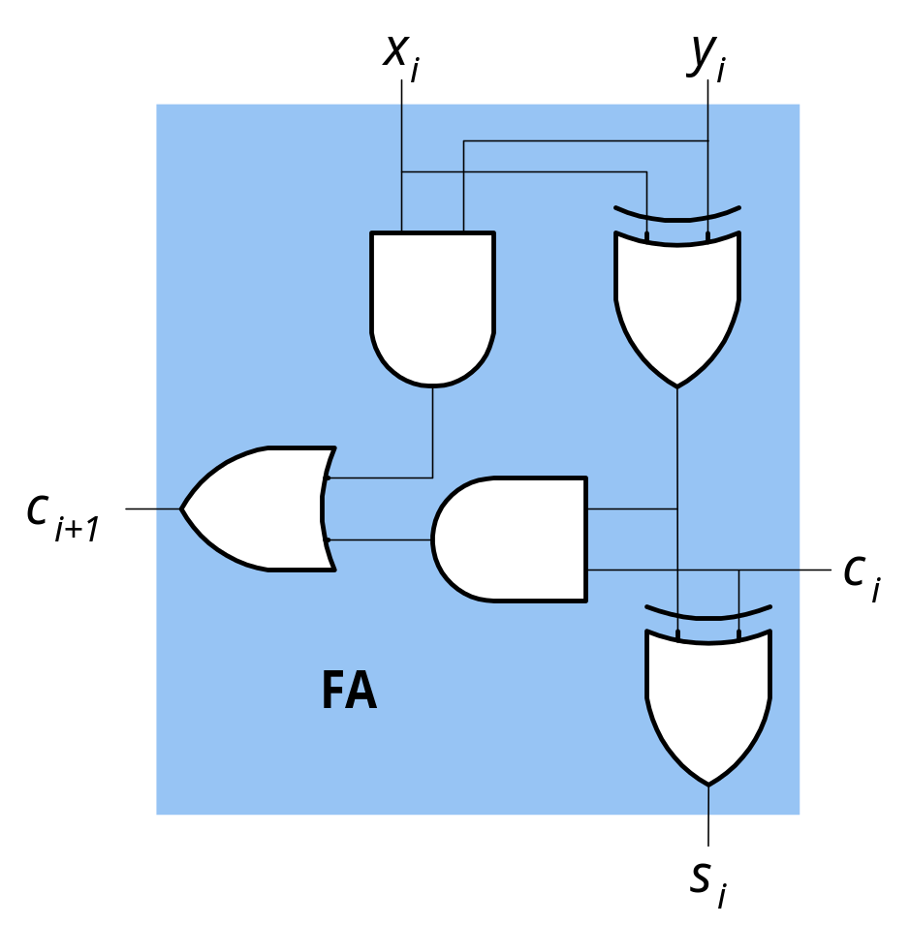
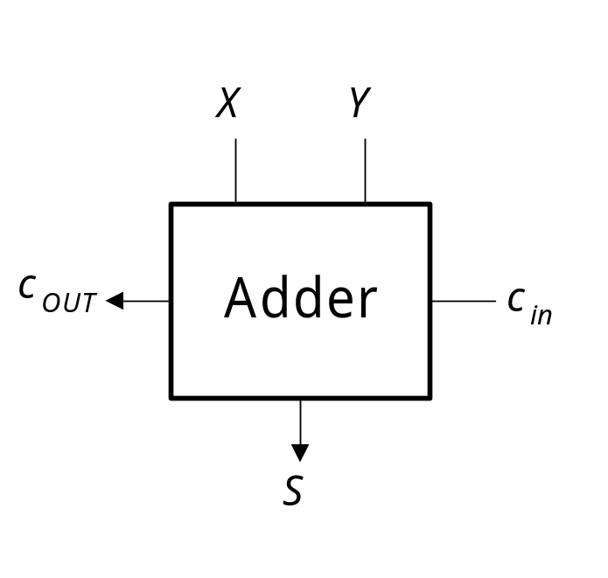
Full Adder
(c) Full-adder logic schematic
(e) Graphic symbol
4 - <number>

Slide 4
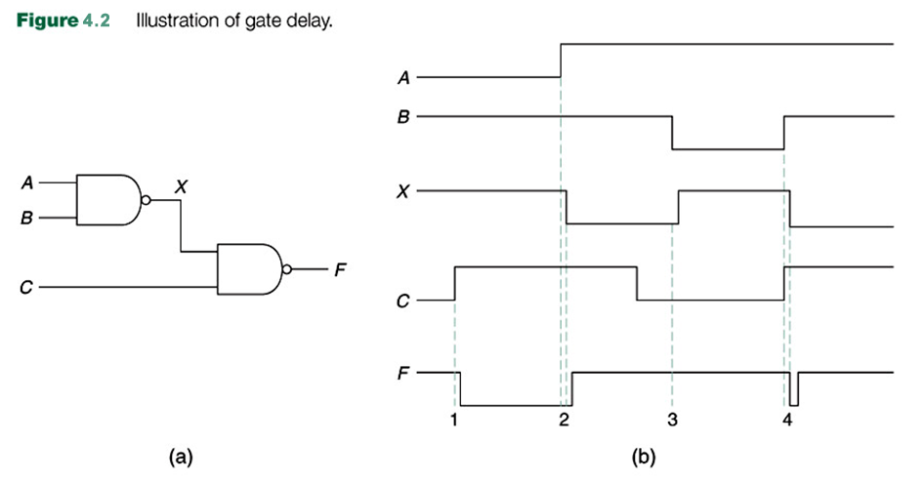
Gate delay
4 - <number>

Slide 5
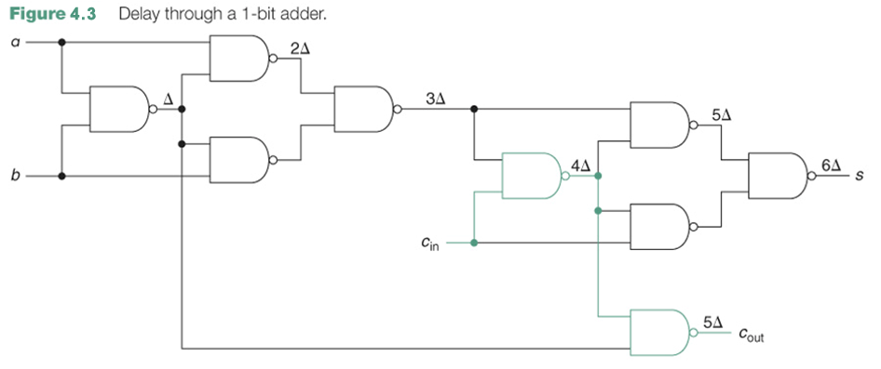
Delay through 1-bit adder (full adder)
N-bit adder can be built by connecting n 1-bit adders (ripple carry adder)
Time for n-bit adder = (2n+4)Δ
4 - <number>

Slide 6
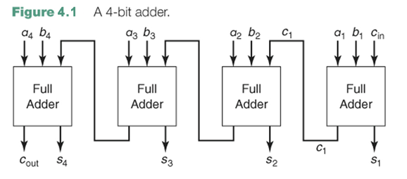
4-bit ripple carry adder
4 - <number>

Slide 7
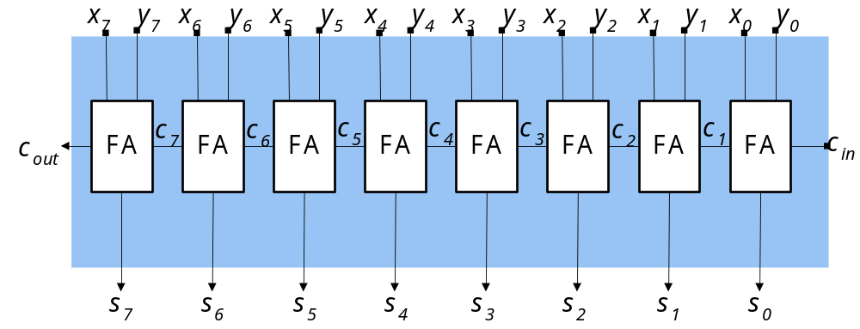
8-bit Ripple carry adder
4 - <number>

Slide 8
Carry look-ahead adders
Advantage of Carry-look-ahead technique
reduce the delay of the carry chain in this kind of ripple-carry chain
x_{i+3} x_{i+2} x_{i+1} x_{i} + y_{i+3} y_{i+2} y_{i+1} y_{i} (input carry c_{i})
carry-generate function g_{i}= x_{i}y_{i}
carry-propagate function p_{i}= x_{i}⊕ y_{i}
c_{i+1}= g_{i}+ p_{i} c_{i} c_{i+2}= g_{i+1}+ p_{i+1} c_{i+1}
c_{i+3}= g_{i+2}+ p_{i+2} c_{i+2} c_{i+4}= g_{i+3}+ p_{i+3} c_{i+3}
Express in terms of c_{i}
c_{i+1}= g_{i}+p_{i}c_{i}
c_{i+2}= g_{i+1}+p_{i+1}g_{i}+p_{i+1}p_{i}c_{i}
c_{i+3}= g_{i+2}+p_{i+2}g_{i+1}+p_{i+2}p_{i+1}g_{i}+p_{i+2}p_{i+1}p_{i}c_{i}
c_{i+4}= g_{i+3}+p_{i+3}g_{i+2}+p_{i+3}p_{i+2}g_{i+1}+p_{i+3}p_{i+2}p_{i+1}g_{i}+p_{i+3}p_{i+2}p_{i+1}p_{i}c_{i}
⇒ can compute directly from input bits and input carry c_{i}
4 - <number>

Slide 9
Carry look-ahead adders
carry-look-ahead(CLA) generator
c_{i+4} = g_{(i,i+3)}+p_{(i,i+3)}c_{i}
  - g_{(i,i+3)} = g_{i+3}+p_{i+3}g_{i+2}+p_{i+3}p_{i+2}g_{i+1}+p_{i+3}p_{i+2}p_{i+1}g_{i}
  - p_{(i,i+3)} = p_{i+3}p_{i+2}p_{i+1}p_{i}
replace the 4-bit carry chain, so make the adder faster
carry-look-ahead adder v.s. ripple-carry-adder
ripple-carry adder
  consist of 4 FA carry chains
  each FA carry chain consists of 1 AND and 1 OR gate, used to compute c_{i+1} = g_{i}+p_{i}c_{i}
carry-look-ahead adder
  - CLA generator can produce 4 carries with less delay than the ripple-carry chain
  - produce a faster 4-bit adder, and improve the speed of larger adders as well
4 - <number>

Slide 10
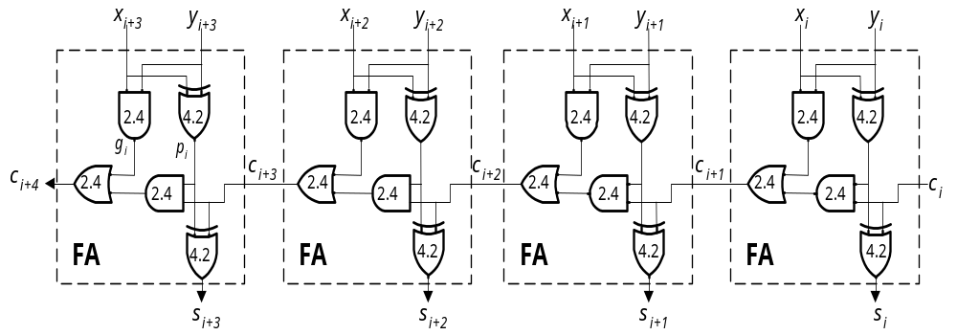
Carry generation of 4-bit ripple carry adder
carry-generate function g_{i}= x_{i}y_{i}
carry-propagate function p_{i}= x_{i}⊕ y_{i}
c_{i+1}= g_{i}+p_{i}c_{i}
c_{i+2}= g_{i+1}+p_{i+1}g_{i}+p_{i+1}p_{i}c_{i}
c_{i+3}= g_{i+2}+p_{i+2}g_{i+1}+p_{i+2}p_{i+1}g_{i}+p_{i+2}p_{i+1}p_{i}c_{i}
c_{i+4}= g_{i+3}+p_{i+3}g_{i+2}+p_{i+3}p_{i+2}g_{i+1}+p_{i+3}p_{i+2}p_{i+1}g_{i}+p_{i+3}p_{i+2}p_{i+1}p_{i}c_{i}
4 - <number>

Slide 11
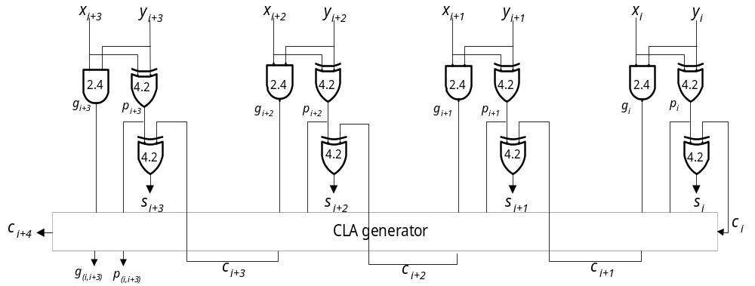
4-bit carry look-ahead adder
4 - <number>

Slide 12
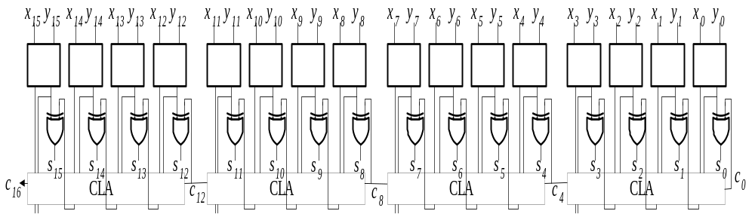
Single-level 16-bit carry look-ahead adder
4 - <number>

Slide 13
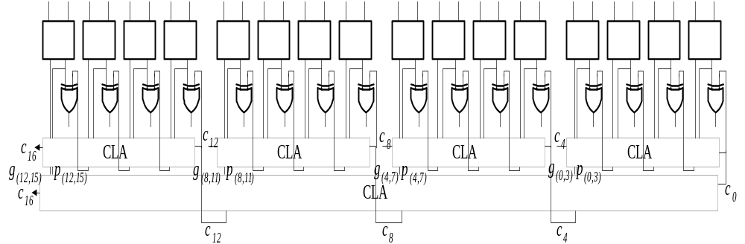
2-level 16-bit carry look-ahead adder
Two-level CLA generator
speed up by using an additional CLA generator
c₄ = g_{(0,3)}+p_{(0,3)}c₀ c₈ = g_{(4,7)}+p_{(4,7)}c₄
c₁₂ = g_{(8,11)}+p_{(8,11)}c₈ c₁₆ = g_{(12,15)}+p_{(12,15)}c₁₂
second level generates these carries for the first-level CLA generator
(b) Two-level CLA generator
4 - <number>

Slide 14
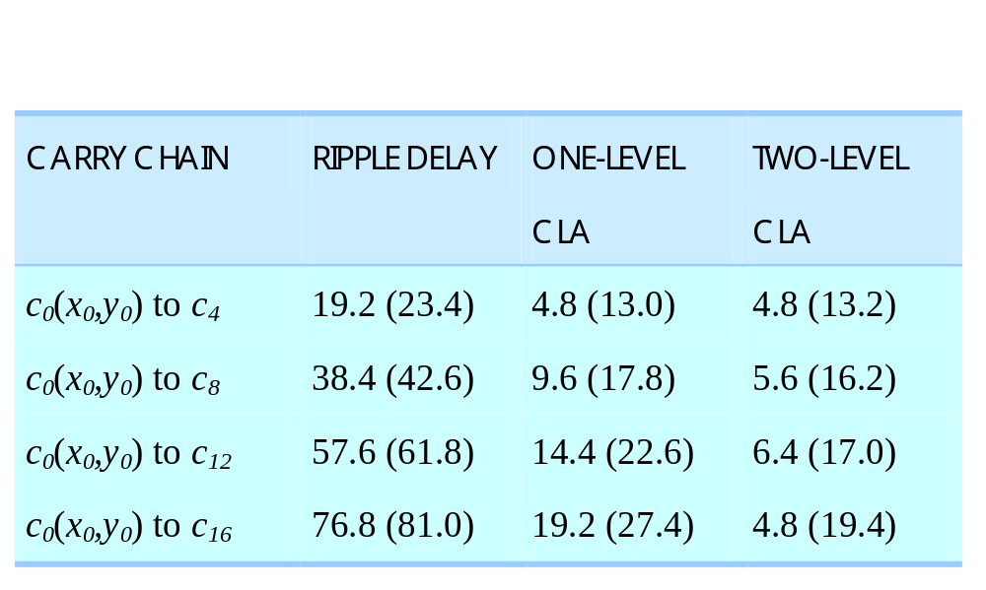
Delay comparison
delay from x₀ or y₀
4 - <number>

Slide 15
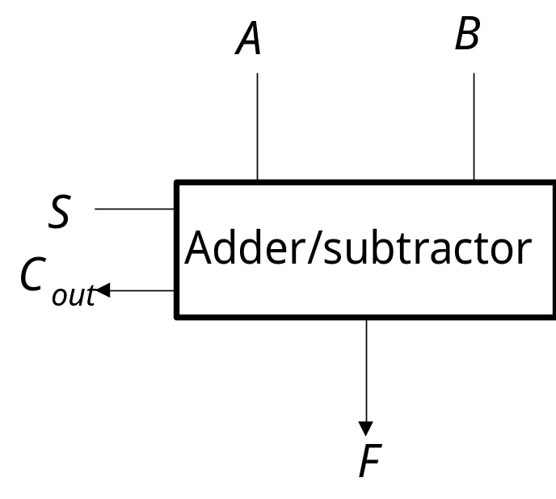
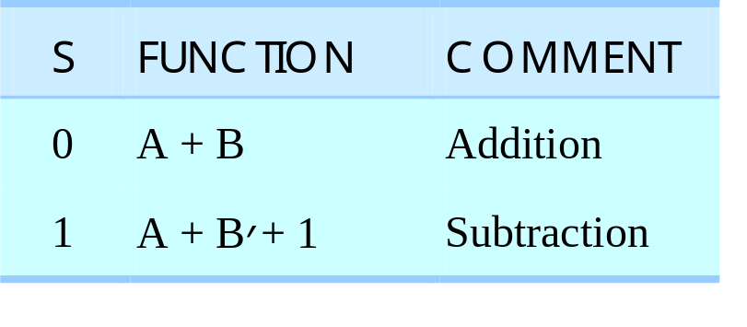
Adders/Subtractors
Binary subtraction
add the minuend to the 2’s complement of the subtrahend
Adders/Subtractor
inputs : A = a_{n-1}…a₀ and B = b_{n-1}…b₀
output : F = f_{n-1}…f₀
select signal : S
(a) Truth table
(b) Graphic symbol
Two’s-complement adder/subtractor
4 - <number>

Slide 16
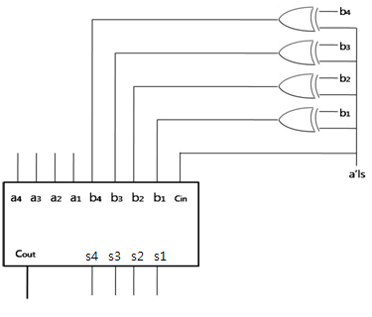
Adders/Subtractors
Subtraction : Develop the truth table for a 1-bit full subtractor and cascade as many of these as are needed, producing a borrow-ripple subtractor.
Adder/Subtractor : signal line = 0 for addition & signal line = 1 for subtraction.
  1 x = x’ and 0 x = x
Figure 4.5
4 - <number>

Slide 17
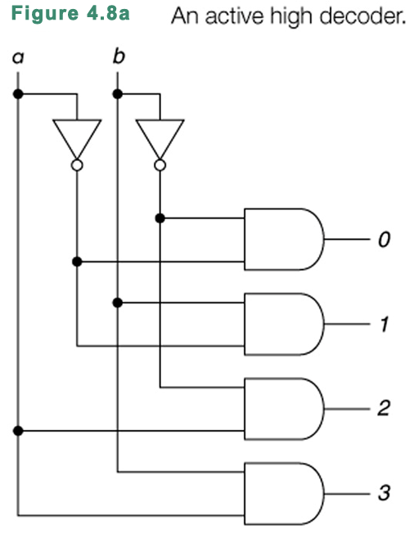
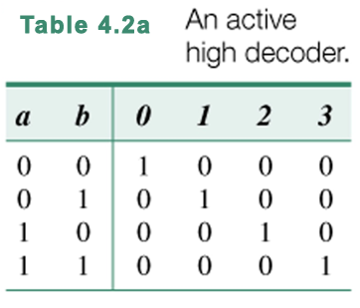
Binary decoders
4 - <number>
Copyright © 2008 The McGraw-Hill Companies, Inc. Permission required for reproduction or display.

Slide 18
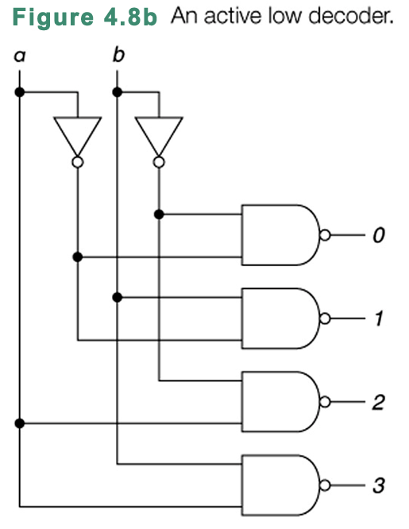
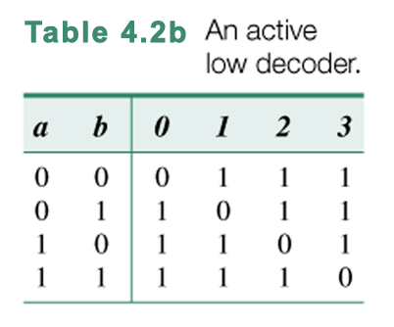
Binary decoders
4 - <number>

Slide 19
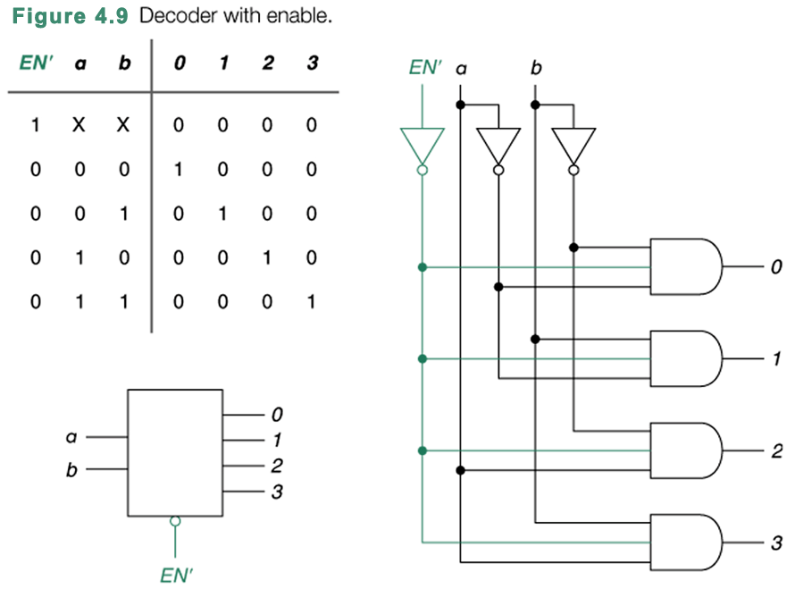
4 - <number>

Slide 20
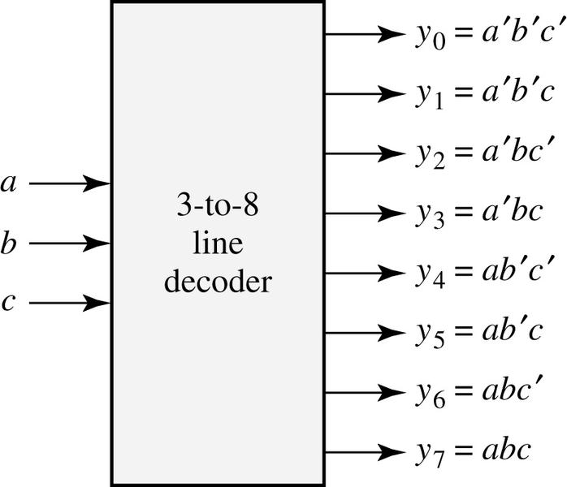
3x8 decoder
a b c | y₀ | y₁ | y₂ | y₃ | y₄ | y₅ | y₆ | y₇
0 0 0 0 0 1 0 1 0 0 1 1 1 0 0 1 0 1 1 1 0 1 1 1 | 1 0 0 0 0 0 0 0 | 0 1 0 0 0 0 0 0 | 0 0 1 0 0 0 0 0 | 0 0 0 1 0 0 0 0 | 0 0 0 0 1 0 0 0 | 0 0 0 0 0 1 0 0 | 0 0 0 0 0 0 1 0 | 0 0 0 0 0 0 0 1
4 - <number>

Slide 21
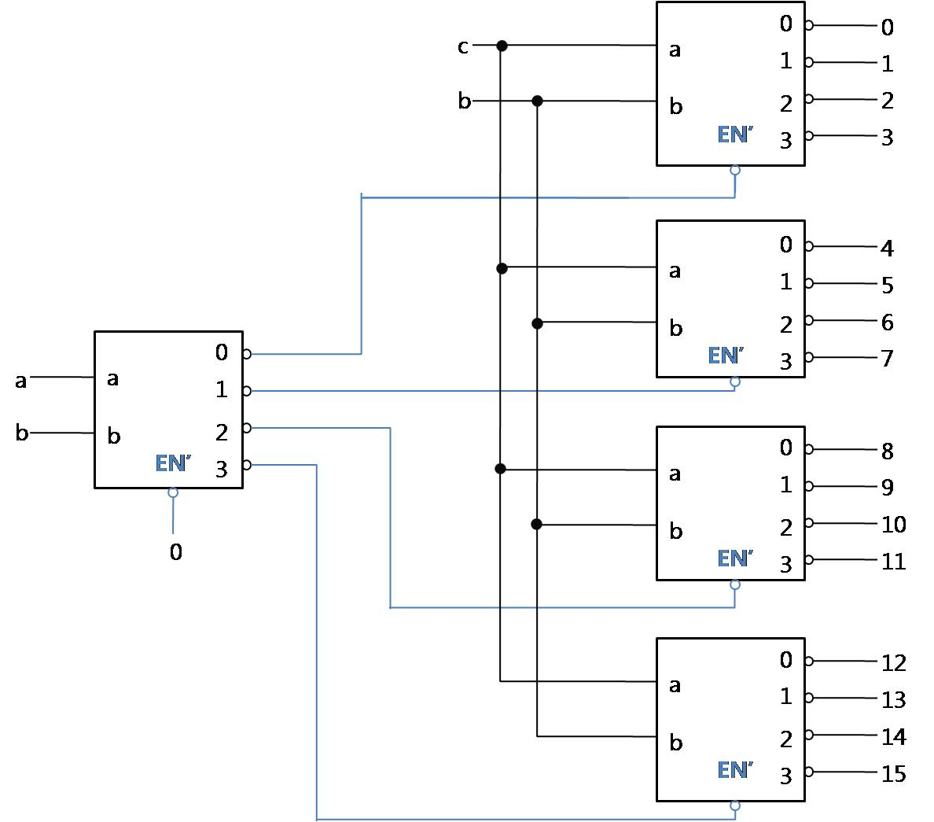
4x16 decoder using 2x4 decoders
4 - <number>

Slide 22
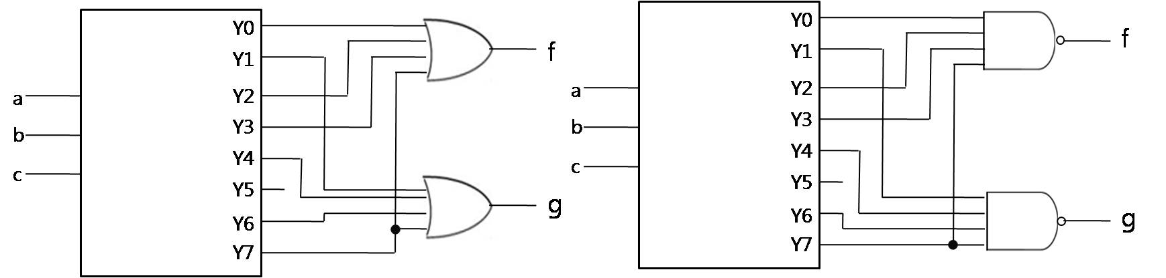
Logic function by decoders
Example 4.3
  Implementation of logic function
  f(a, b, c) = ∑m(0, 2, 3, 7)
  g(a, b, c) = ∑m(1, 4, 6, 7)
4 - <number>

Slide 23
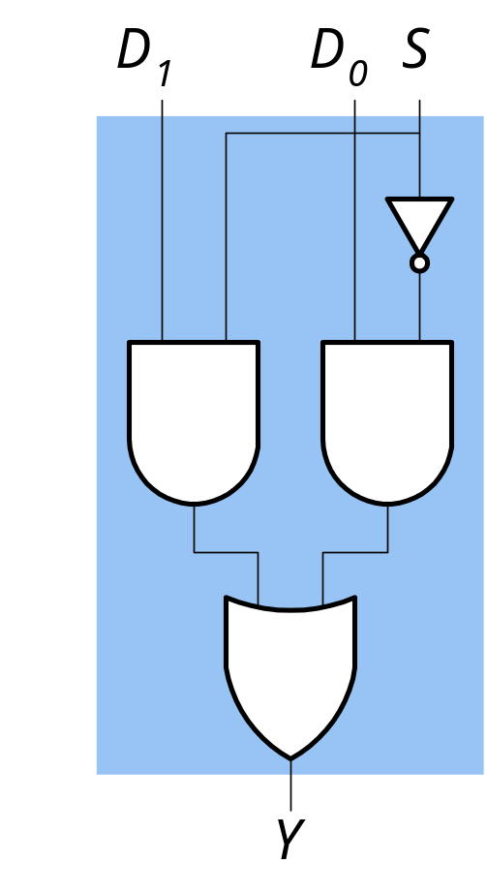
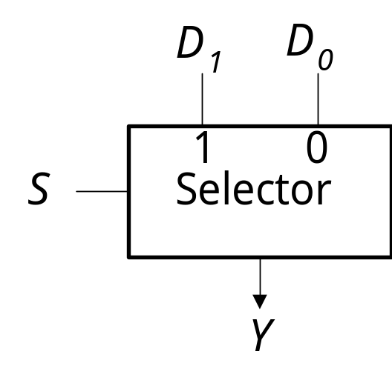
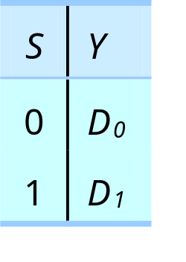
Multiplexers (data selectors)
combinatorial component that can select one of several data sources to be used as operands for an ALU
n inputs, one output, log₂n select signals
Y = S´D₀ + SD₁
(a) Graphic symbol
(b) Truth table
(c) Boolean expression
(d) Logic diagram
4 - <number>

Slide 24
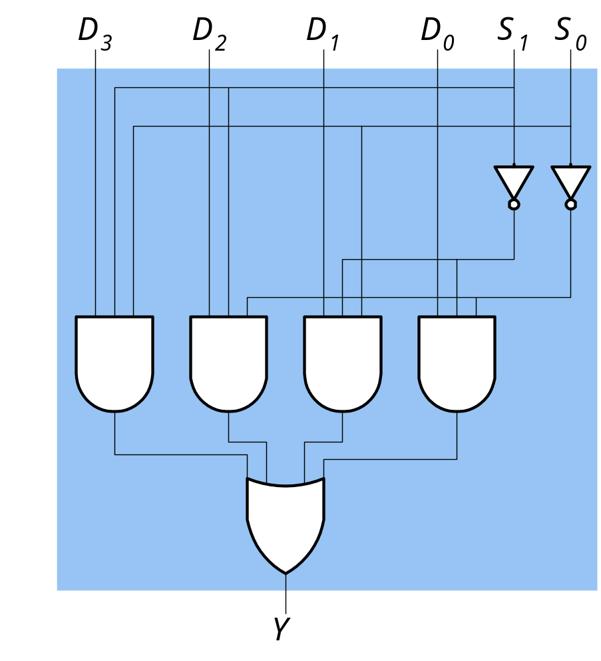
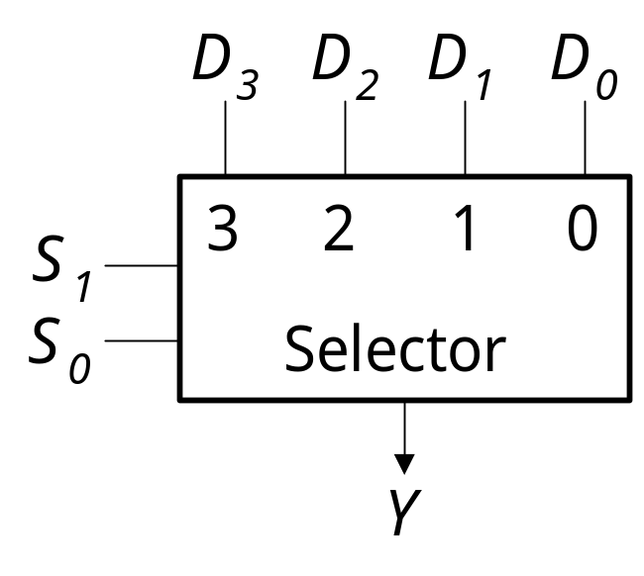
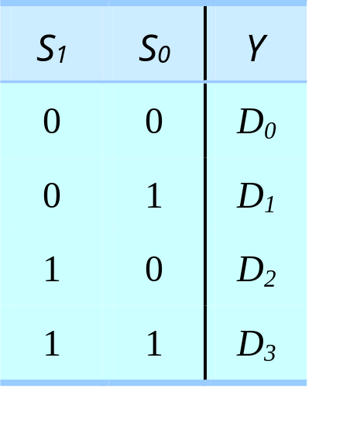
4x1 Mutiplexer
(a) Graphic symbol
(b) Truth table
Y = S₁´S₀´D₀ + S₁´S₀D₁ + S₁S₀´D₂ + S₁S₀D₃
(c) Boolean expression
(d) Logic diagram
4 - <number>

Slide 25
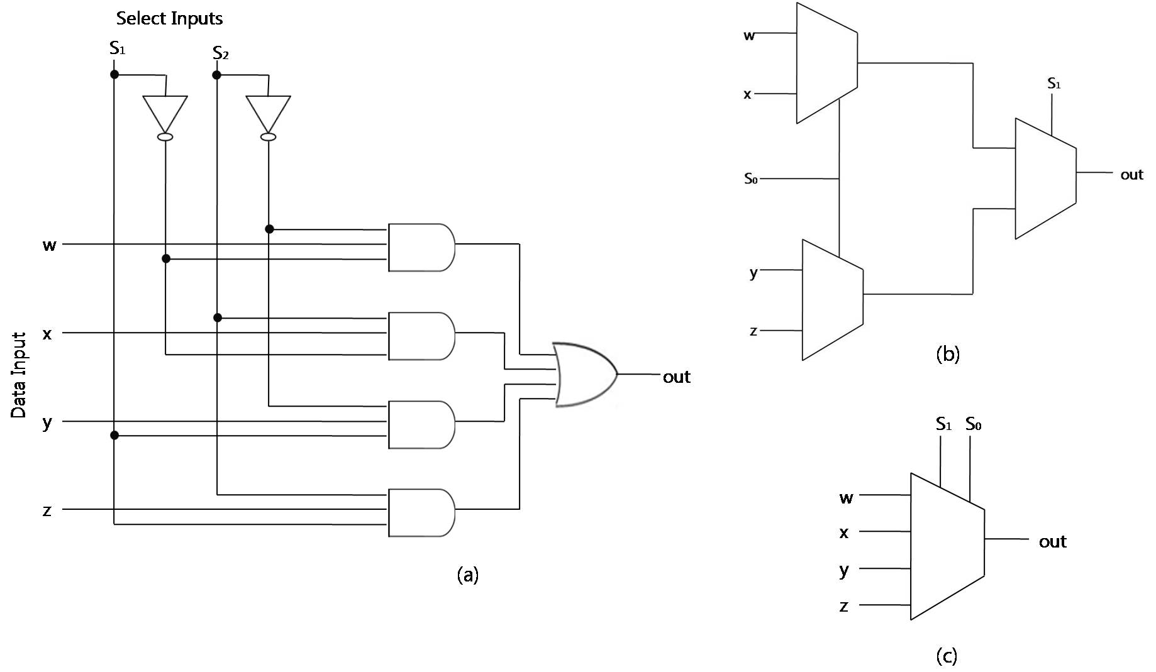
4x1 MUX using 3 (2x1) MUX
4 - <number>

Slide 26
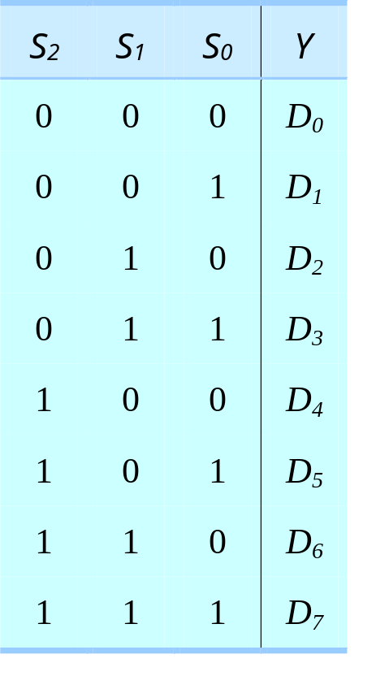
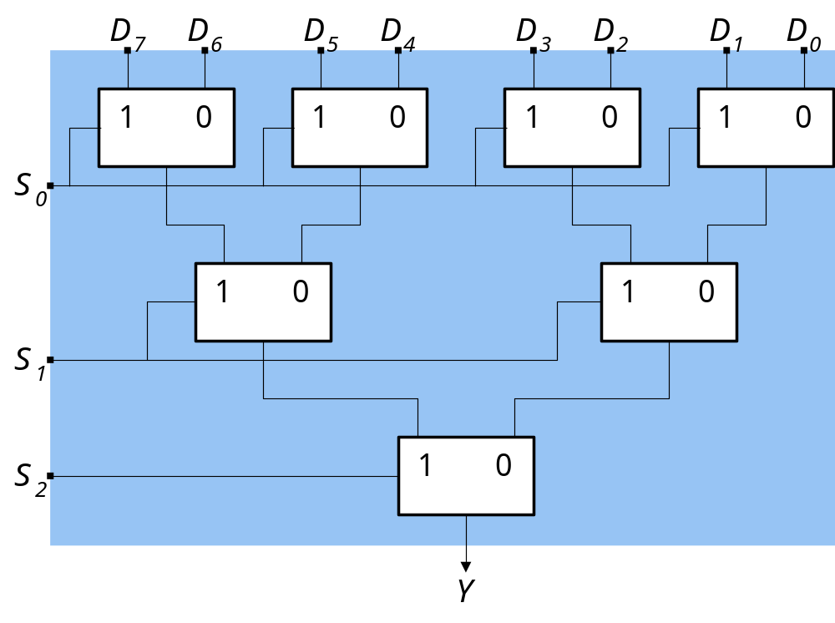
8x1 Multiplexer (1)
(a) Truth table
(b) Implementation with 2-to-1 selectors
4 - <number>

Slide 27
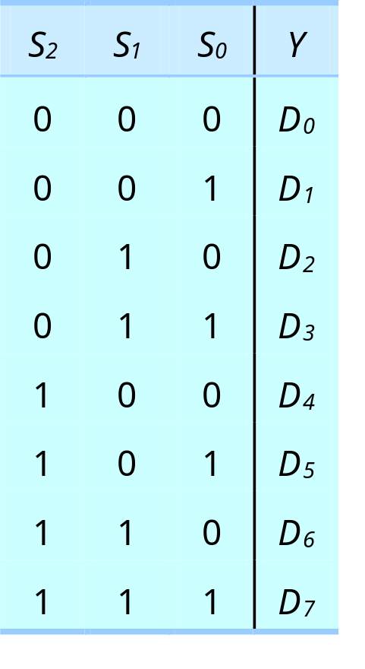
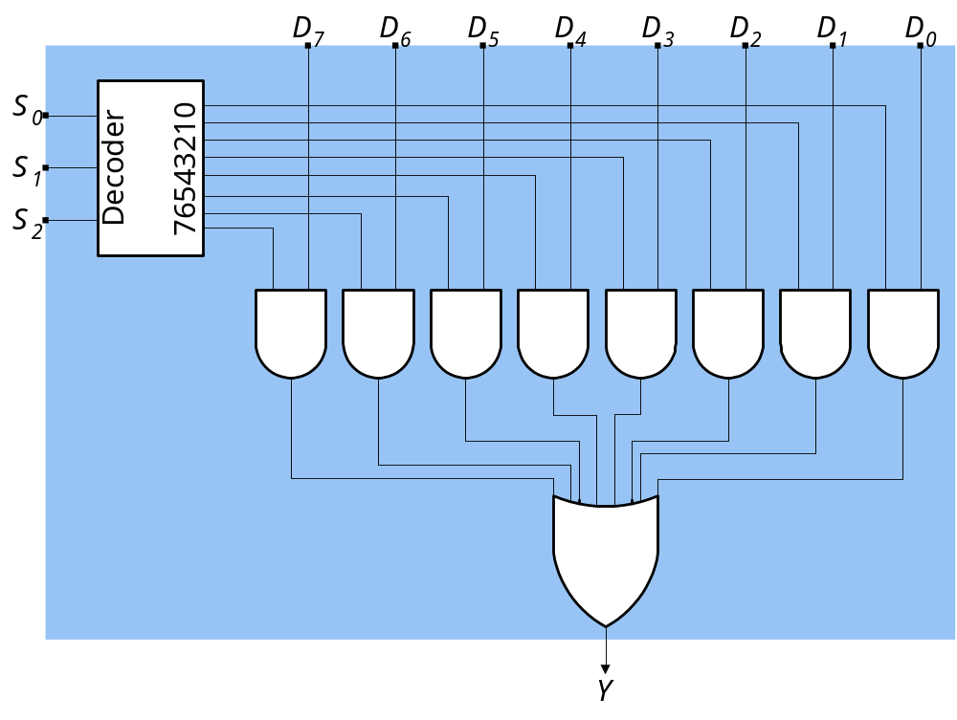
8x1 multiplexer (2)
(a) Truth table
(b) Implementation with a decoder
4 - <number>

Slide 28
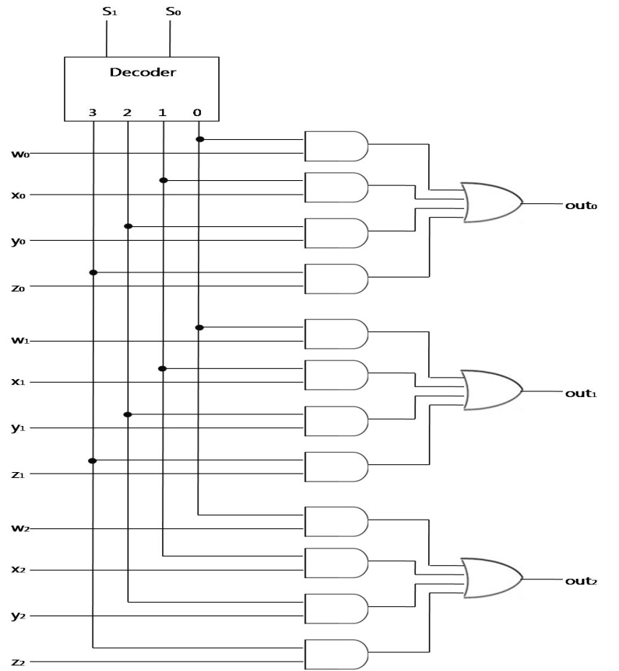
Multi-bit multiplexer
4 - <number>

Slide 29
Function implementation using mux
Multiplexers can be used to implement logic functions.
Example 4.4
  Implement the function
  f(a, b) = ∑m(0, 1, 3)
a
b
a | b | f
0 | 0 | 1
0 | 1 | 1
1 | 0 | 0
1 | 1 | 1
1
1
f
0
1
4 - <number>

Slide 30

Three state gates (buffers)
EN | a | F
0 | 0 | Z
0 | 1 | Z
1 | 0 | 0
1 | 1 | 1
a
EN
EN
f
a
f
b
Figure 4.15
  Three-state buffers with active low enables and/or outputs exist.
  Three-state outputs also exist on other more complex gates.
  A multiplexer using three-state gates. (without the OR gate)
    The enable is the control input : f = a (EN = 0) or f = b (EN = 1)
    The three-state gate is often used for signals that travel between systems.
    bus : it is a set of lines over which data is transferred.
4 - <number>

Slide 31
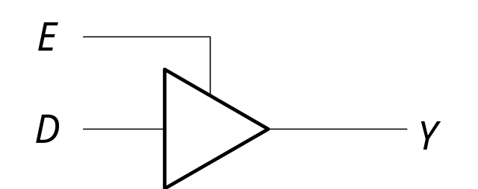
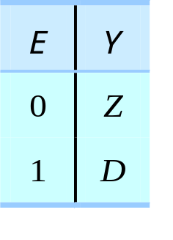
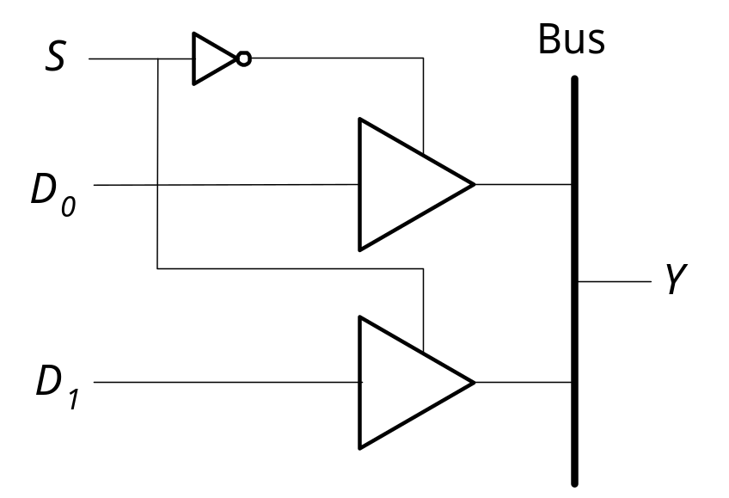
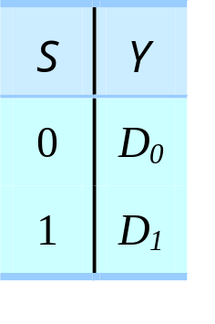
BUS
enable line
output line
data line
(a) Tristate driver symbol
(b) Truth table for tristate driver
(d) Truth table for 2-input bus
(c) 2-input bus
4 - <number>

Slide 32
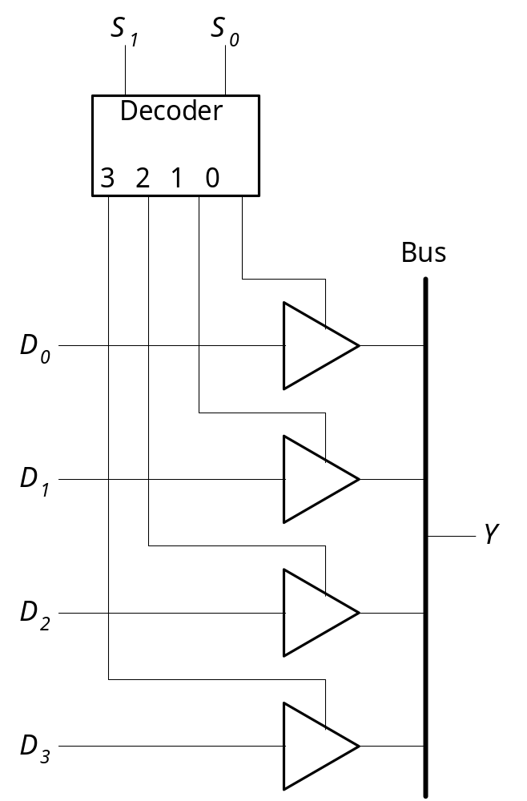
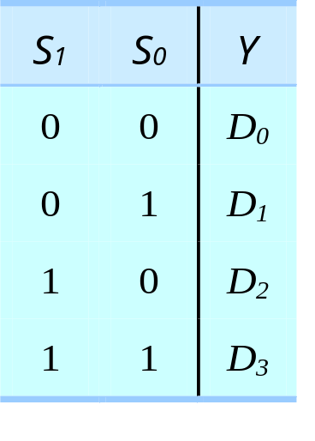
bus
(f) Truth table for 4-input bus
(e) 4-input bus
4 - <number>

Slide 33
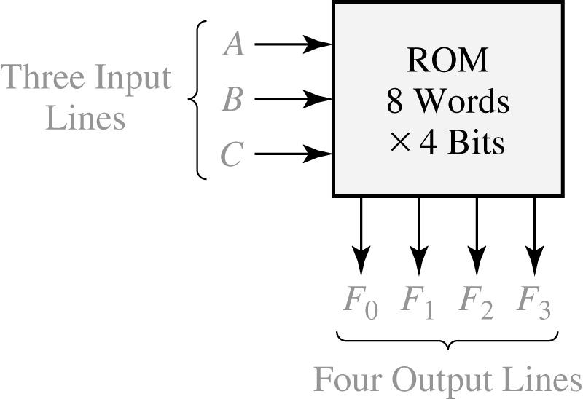
Read-Only Memory (ROM)
An 8-Word x 4-Bit ROM
A | B | C |  |  | F₀ | F₁ | F₂ | F₃
0 0 0 0 1 1 1 1 | 0 0 1 1 0 0 1 1 | 0 1 0 1 0 1 0 1 |  |  | 1 1 0 0 1 0 1 0 | 0 0 1 1 1 0 1 1 | 1 1 1 0 0 0 1 0 | 0 0 1 1 0 1 1 1
typical data stored in ROM
(2³ words of
4bits each)
(a) Block diagram
(b) Truth table for ROM
4 - <number>

Slide 34
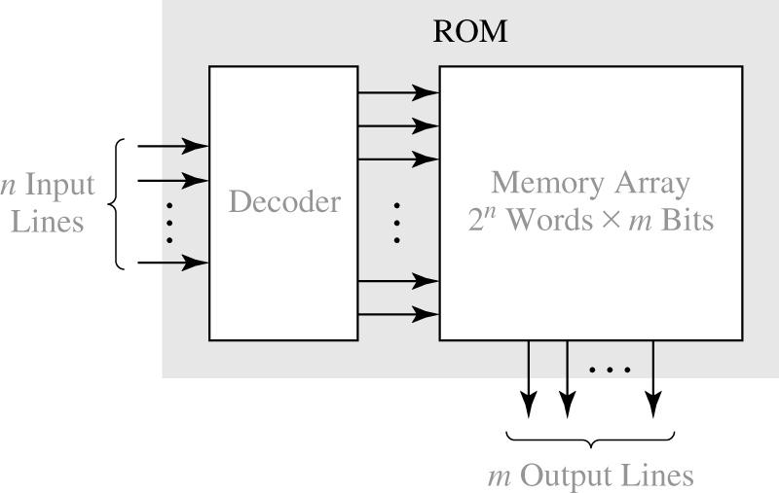
Basic ROM structure
4 - <number>

Slide 35
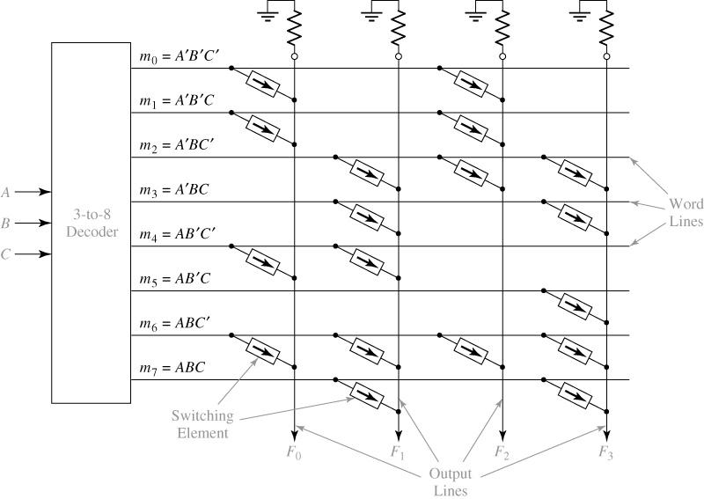
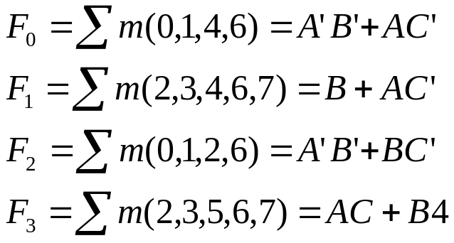
An 8-Word x 4-Bit ROM
4 - <number>

Slide 36
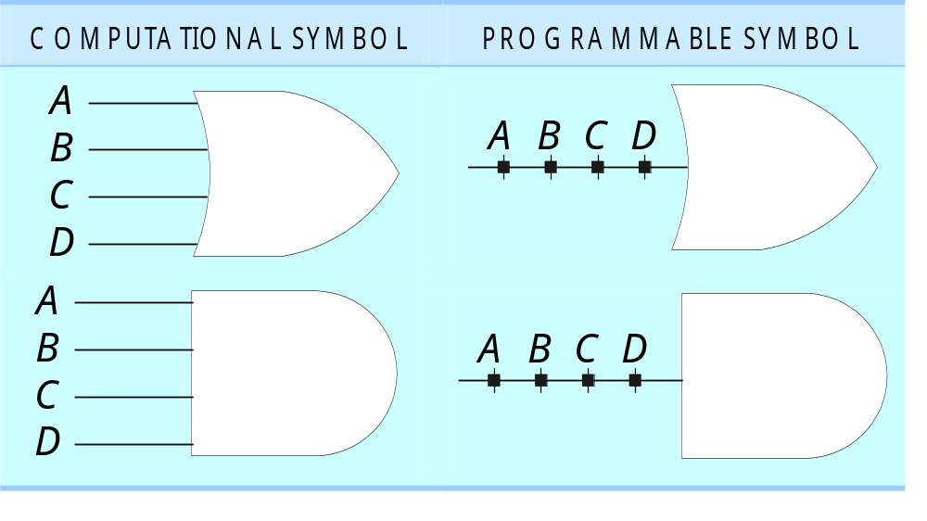
ROM
programmable versions of the conceptional AND and OR gate
connections are made
  - during manufacturing, when physically connect two lines whenever a connection is desired
  - in the field, when burn the fuse between an input line and a gate line whenever a connection is not desired
4 - <number>

Slide 37
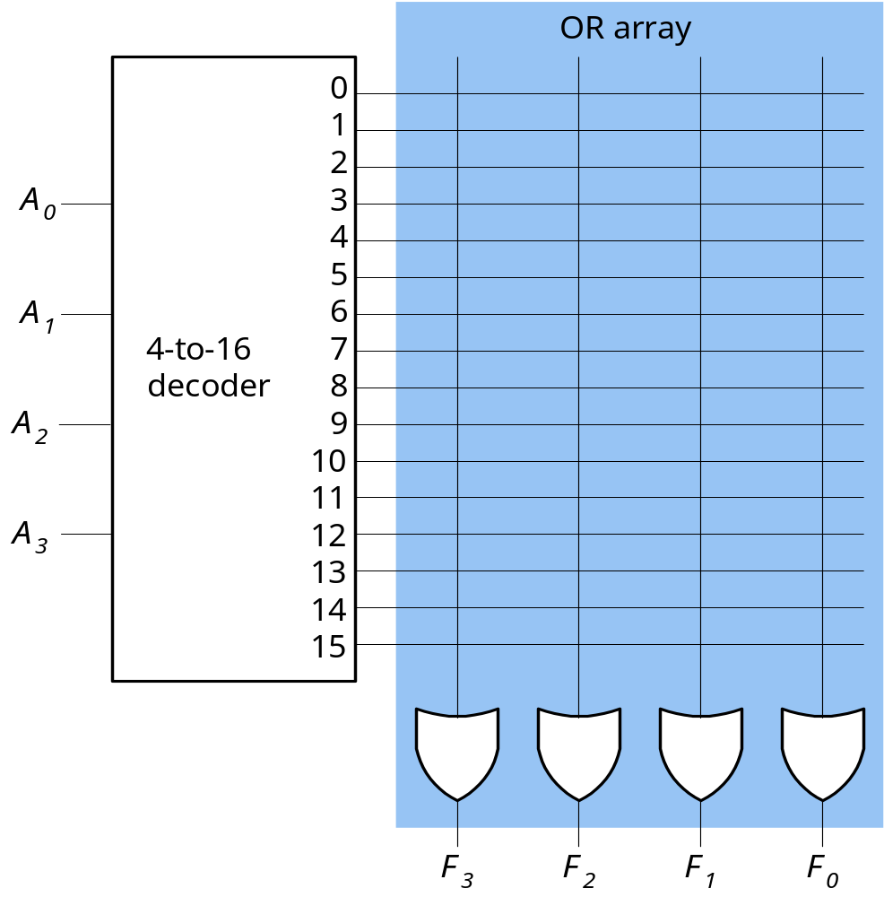
16 × 4 ROM
programmable OR array
k-to-n address decoder
(k = log₂n)
4 - <number>

Slide 38
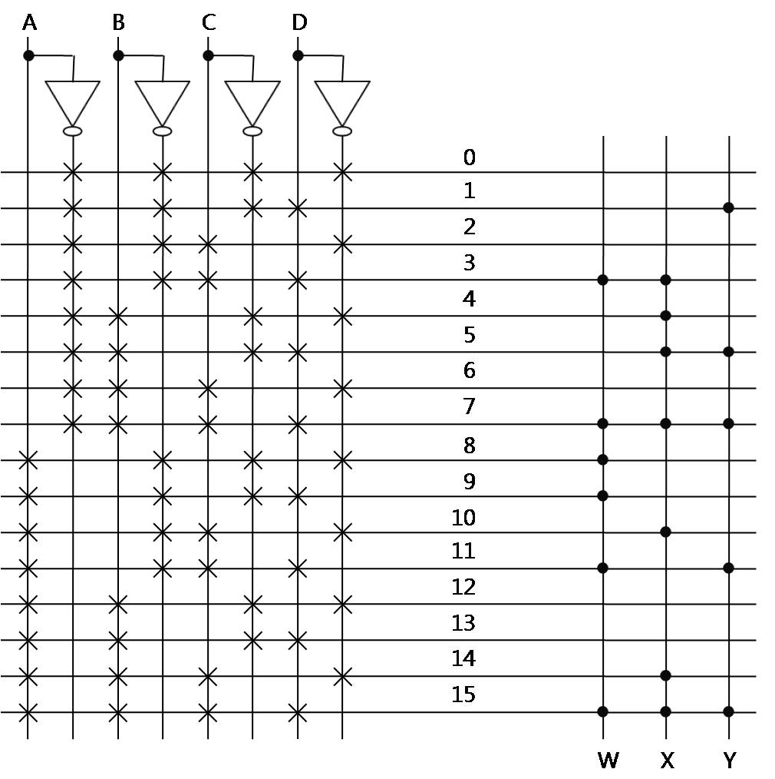
Designing with Read-Only Memories
Example 4.7
  W(A, B, C, D) = Σm(3, 7, 8, 9, 11, 15), X(A, B, C, D) = Σm(3, 4, 5, 7, 10, 14, 15), Y(A, B, C, D) = Σm(1, 5, 7, 11, 15)
4 - <number>

Slide 39

Hexadecimal to ASCII Code Converter
Input |  |  |  | Hex Digit |  |  | ASCII Code for Hex Digit
W | X | Y | Z |  |  |  | A₆ | A₅ | A₄ | A₃ | A₂ | A₁ | A₀
0 0 0 0 0 0 0 0 1 1 1 1 1 1 1 1 | 0 0 0 0 1 1 1 1 0 0 0 0 1 1 1 1 | 0 0 1 1 0 0 1 1 0 0 1 1 0 0 1 1 | 0 1 0 1 0 1 0 1 0 1 0 1 0 1 0 1 |  | 0 1 2 3 4 5 6 7 8 9 A B C D E F |  | 0 0 0 0 0 0 0 0 0 0 1 1 1 1 1 1 | 1 1 1 1 1 1 1 1 1 1 0 0 0 0 0 0 | 1 1 1 1 1 1 1 1 1 1 0 0 0 0 0 0 | 0 0 0 0 0 0 0 0 1 1 0 0 0 0 0 0 | 0 0 0 0 1 1 1 1 0 0 0 0 0 1 1 1 | 0 0 1 1 0 0 1 1 0 0 0 1 1 0 0 1 | 0 1 0 1 0 1 0 1 0 1 1 0 1 0 1 0
4 - <number>

Slide 40

ROM realization of code converter
4 - <number>

Slide 41
PROGRAMMABLE LOGIC ARRAYS
ROMs
have only a small number of 1’s, so many of the words have a value of 0
  programmable logic arrays (PLAs) minimize this waste
PLAs differ from ROMs in the address decoder
instead of a full decoder, use a programmable decoder (AND array), which can be programmed to decode only those words that have a nonzero content
programmable output array used whenever to complement the output values
Advantage of PLAs
no less flexible than ROMs
more efficient in their implementation of random logic
used more often for the implementation of control logics, whereas ROMs are used most frequently for tables of coefficients, startup programs, test vectors, and other random data
4 - <number>

Slide 42

Programmable Logic Devices
Programmable Logic Array Structure
4 - <number>

Slide 43



PLA implementation of the full adder
x_{i}y_{i}
c_{i}
x_{i}y_{i}
c_{i}
4 - <number>

Slide 44

PLA implementation of full-adder
4 - <number>

Slide 45

Designing with Programmable Logic Arrays
Example 4.8
  W(A, B, C, D) = Σm(3, 7, 8, 9, 11, 15), X(A, B, C, D) = Σm(3, 4, 5, 7, 10, 14, 15), Y(A, B, C, D) = Σm(1, 5, 7, 11, 15)
  W= AB’C’ + CD
  X = A’BC’ + A’CD + ACD’ + {BCD or ABC}
  Y = A’C’D + ACD + {A’BD or BCD}
4 - <number>

Slide 46

PLA example
  W= AB’C’ + A’CD + ACD
  X = A’BC’ + ACD’ + A’CD + BCD
  Y = A’C’D + ACD + BCD
This solution only uses seven terms instead of eight or nine.
4 - <number>

Slide 47


solution
A
B
C
D
AB’C’
CD
A’BC’
A’CD
ACD’
BCD
A’C’D
ACD
ABC
A’BD
W
X
Y
W
X
Y
4 - <number>

Slide 48

Programmable logic array (PAL) devices
4 - <number>

Slide 49


Implementation of a Full Adder Using a PAL
4 - <number>

Slide 50

Example 4.11
The three green terms are essential prime implicants of each function but other two are not.
  f = a’b’c’ + a’c’d + b’c’d + abd’ + bcd’
  g = a’b’c’ + a’c’d + b’c’d + abc + acd’
  h = a’b’c’ + a’c’d + b’c’d + a’cd’ + b’cd’
4 - <number>

Slide 51

PAL solution
4 - <number>

